Slide 1

Deploying jar file into Jfrog using maven deploy

Slide 2
Installing Jfrog
sudo su -wget https://releases.jfrog.io/artifactory/bintray-artifactory/org/artifactory/oss/jfrog-artifactory-oss/[RELEASE]/jfrog-artifactory-oss-[RELEASE]-linux.tar.gz?_gl=1*1li7shh*_ga*NDE5NTQ4Mzk4LjE2NTc3OTg1NTM.*_ga_SQ1NR9VTFJ*MTY1Nzg3NzAzNi40LjEuMTY1Nzg3NzA4NS4xMQ..

Slide 3
After installation
Step1 : untar the file by running the command <tar xf file>.
Step2: change the directory to extracted file artifactory-oss-7.41.7.
Step3: change directory to app.
Step4: change the directory to bin.
Step5: Run the file artifactory.sh by using command <./artrifactory.sh>

Slide 4
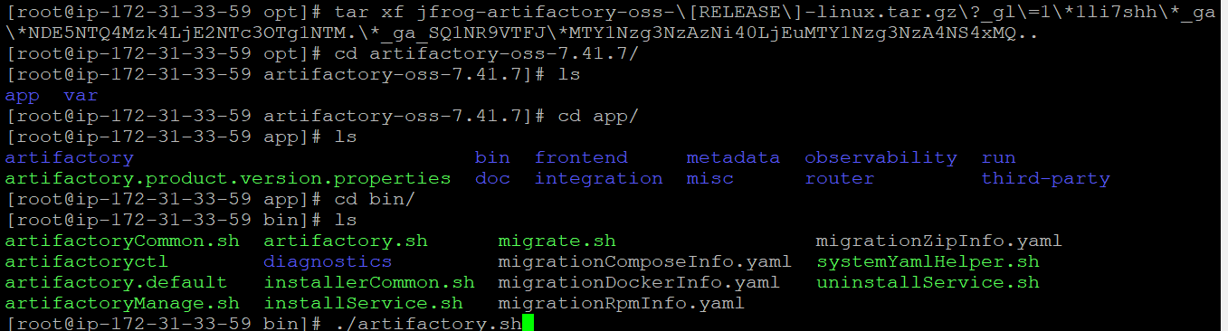

Slide 5
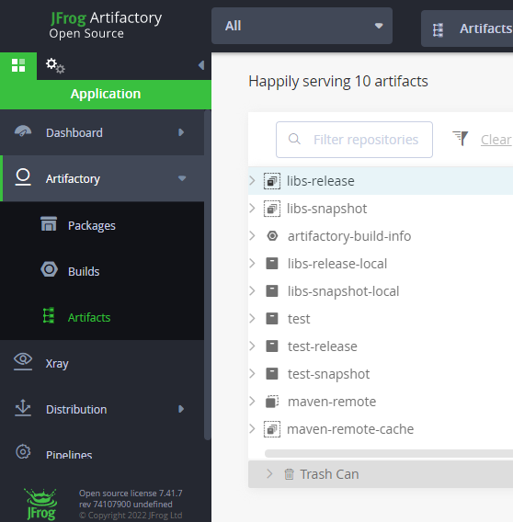
To run the Jfrog, copy the instance IP&paste it in browser <instance IP:8082>
Click on home button & choose the artifacats.

Slide 6
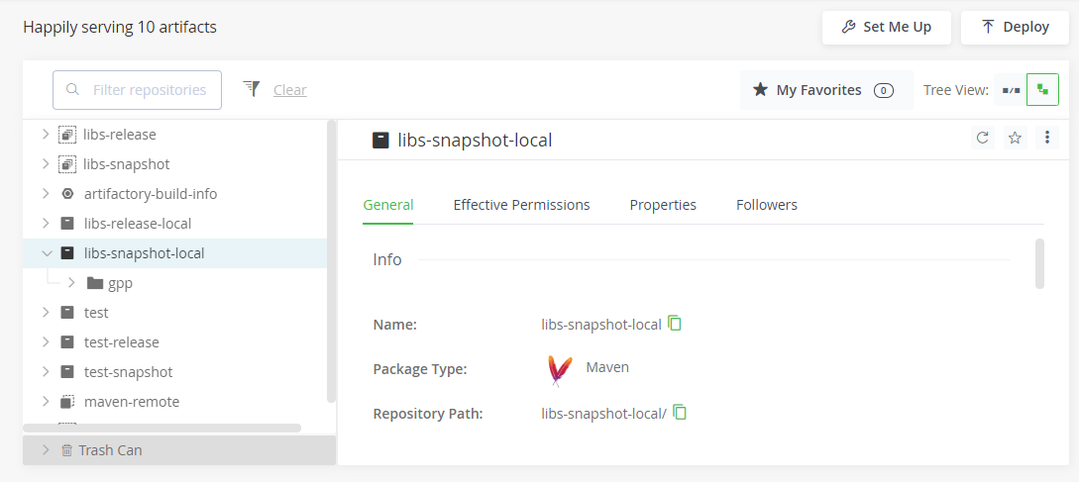
Click on set me up

Slide 7
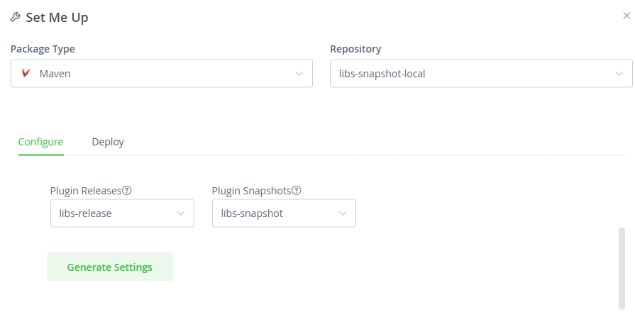
Choose the repository & package type select the Deploy

Slide 8
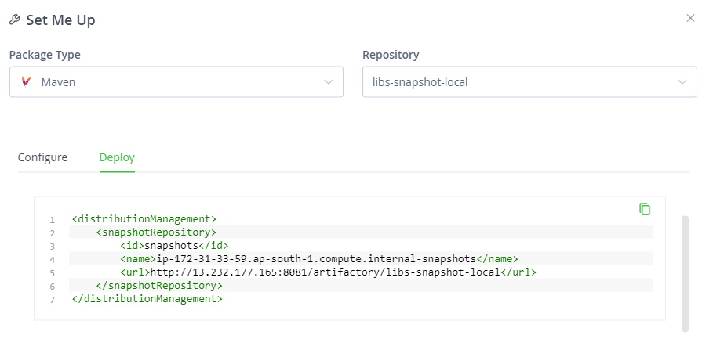
Copy the distribution management

Slide 9
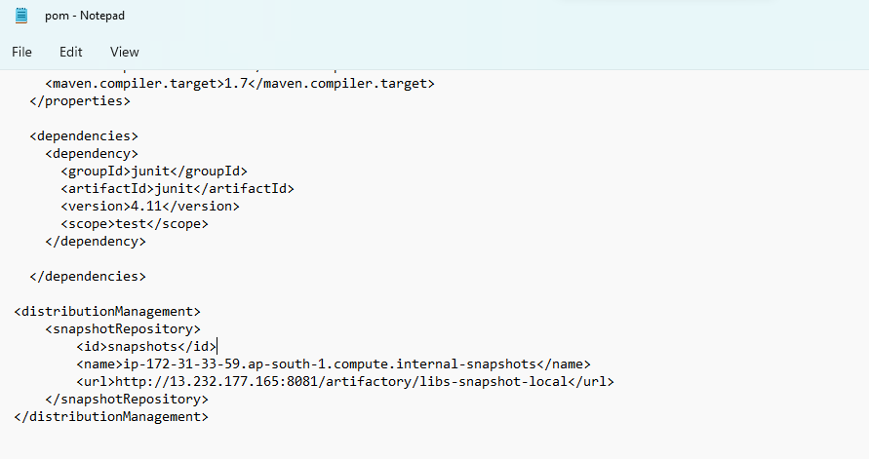
Adding the Distribution management in pom.xml file
Pom.xml file

Slide 10
Distribution management code
<distributionManagement>
<snapshotRepository>
<id>snapshots</id>
<name>ip-172-31-33-59.ap-south-1.compute.internal-snapshots</name>
<url>http://13.232.177.165:8081/artifactory/libs-snapshot-local</url>
</snapshotRepository>
</distributionManagement>

Slide 11
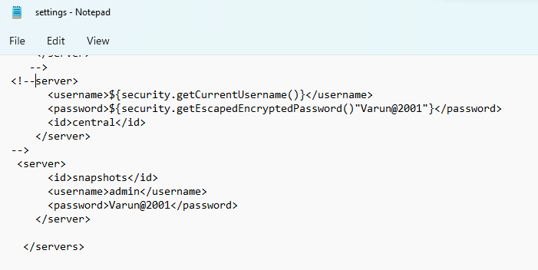
Settings.xml file

Slide 12
Adding the credentials of Jfrog for Authentication in maven settings.xml
<server>
<id>snapshots</id>
<username>un of jfrog</username>
<password>password of jfrog</password>
</server>

Slide 13
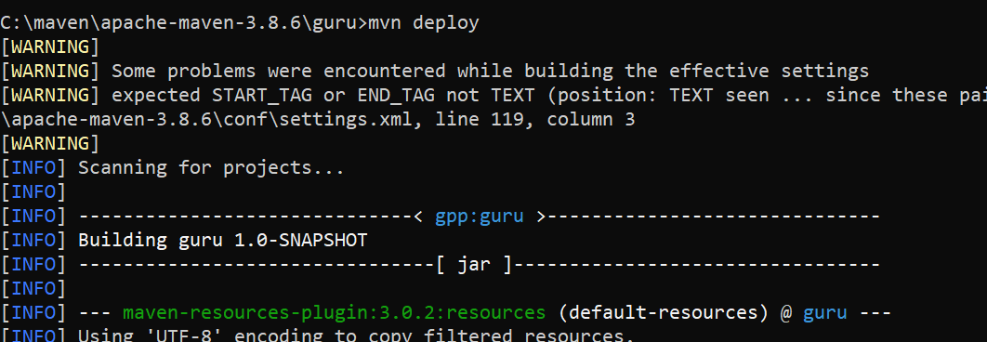
Run the command <mvn deploy>

Slide 14
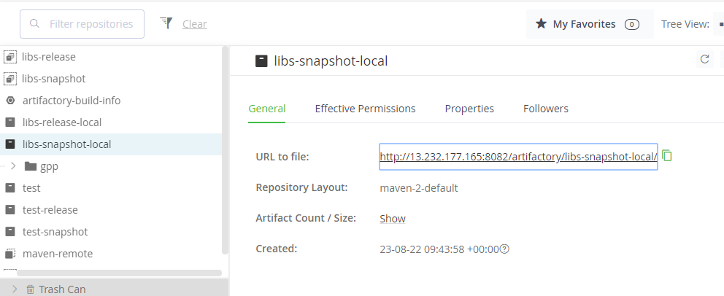
Click on the link to check whether the artifacts are deployed .

Slide 15
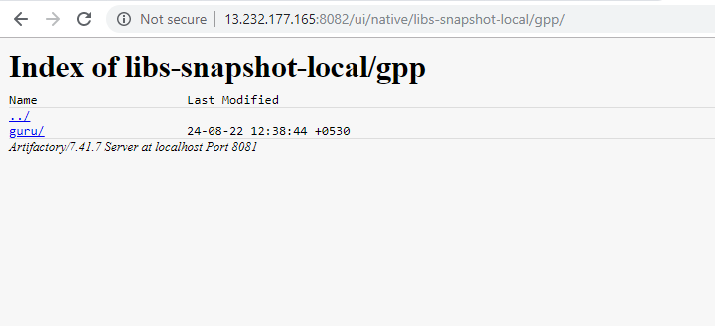
Click the project name

Slide 16
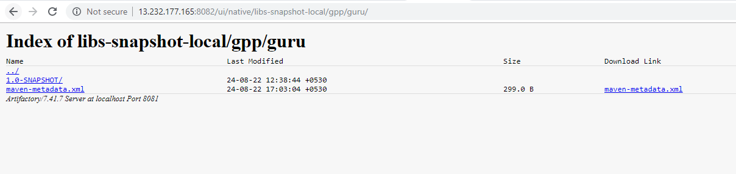
Click on the download link to Download The artefact.

Slide 17
Thank you

